Slide 1
NLP on tweets: Analyzing twitter data about sexual abuse and assault
Prabha Nayak
December 3, 2019

Slide 2
Slide Title Comes Here
Slide with Large Type Subtitle
The copy you are now reading is not the actual text to be typeset. It is placed here in lieu of the type to be used, so that it will resemble a complete job in every respect.
The copy you are now reading is not the actual text to be typeset.
This is placed here in lieu of the type to be used.

Slide 3
Methods 1. Accessing Twitter public API to obtain data
Create a twitter account if you do not already have one.
Go to https://apps.twitter.com/ and log in with your twitter credentials.
Click "Create New App"
Fill out the form, agree to the terms, and click "Create your Twitter application"
In the next page, click on "API keys" tab, and copy your "API key" and "API secret".
Scroll down and click "Create my access token“ and copy your "Access token" and "Access token secret".
Number of rows = 19862
Number of features = 68

Slide 4
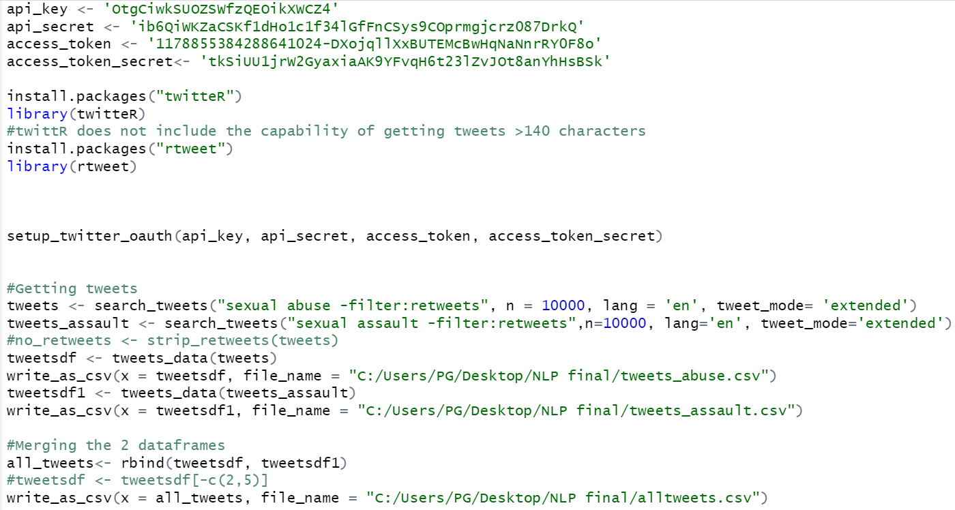

Slide 5
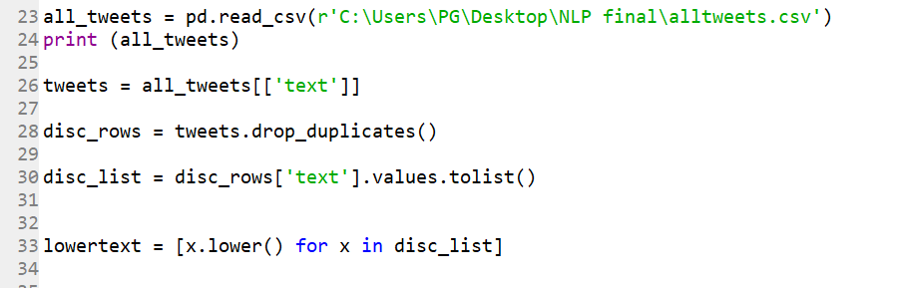
2. Preprocessing of data
Convert to lowercase
Column ‘text’ extracted from the all_tweets dataframe
Text converted to lowercase using lower()

Slide 6
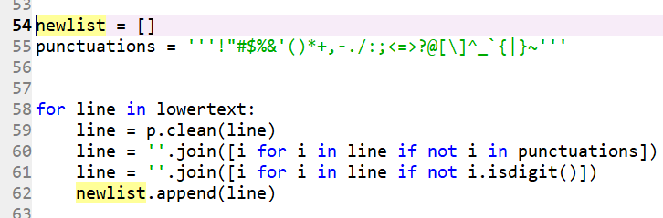
2. Preprocessing of data
b. Remove URL, Punctuations and numbers

Slide 7
2. Preprocessing of data
c. Remove duplicates
Each tweets ends with a distinct url
So removing duplicates preferred after removing the urls from tweets

